Slide 1

Codeasylums-Case Study Challenge Recommendation
By- Pratik Jaiswal

Slide 2
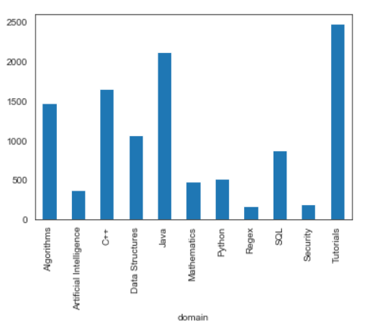
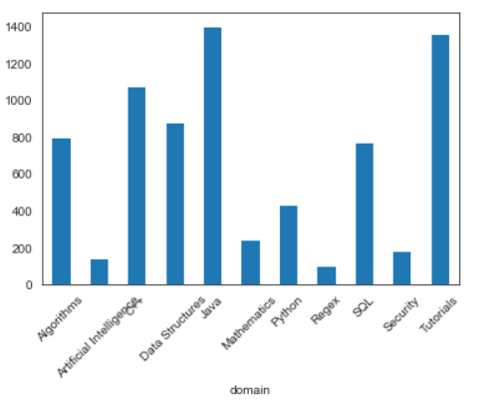
Data Analysis
Given Files:
Challenges, Submissions
Challenges:
Contains data about challenge-ids, contest-ids, domain, difficulty , solved counts,etc.
By EDA, its found that problems belonging to Implementation,Introduction and Sorting have the 3 highest number of challenges.
Belonging to Domain, Tutorials, Java and C++ were the three highest with respect to number of total submissions.

